Slide 1



Tutorial 08, 16th of June 2025
Optimal Abatement
in a static macroeconomy
The Economics of Climate Change
Dr. Sijmen Duineveld

Slide 2
Agenda
Note: Assignment 05 online today, due next week before class
Ingredients of Integrated Assessment Model (like DICE)
Simple Environmental Macro Model
Social Cost of Carbon
Marginal Abatement Costs
Adding utility function to E-Macro model
Labor supply in E-Macro model
Some code to reproduce figures with matlab: https://github.com/saduineveld/Economics_of_Climate_Change_2025

Slide 3
Integrated Assessment Models: Interaction Economy, GHGs, and Climate
Economy
GHG-emissions
Climate
change
Damage
What does each component look like in an Integrated Assessment Model? (For example DICE)
“Economy” can include anything. Also aspects with a non-market valuation (ecosystems, health, et cetera).

Slide 4
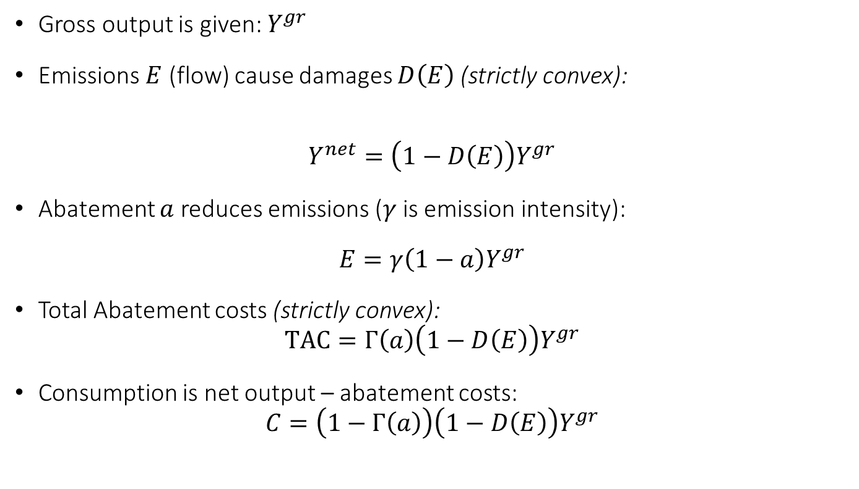
Simple Environmental Macro Model
Gross output is given: $Y^{gr}$
Emissions $E$ (flow) cause damages $D\left(E\right)$ (strictly convex):
$$Y^{net}=\left(1−D\left(E\right)\right)Y^{gr}$$
Abatement $a$ reduces emissions ($γ$ is emission intensity):
$E=γ{\left(1−a\right)Y}^{gr}$
Total Abatement costs (strictly convex):
$$TAC=Γ\left(a\right)\left(1−D\left(E\right)\right)Y^{gr}$$
Consumption is net output – abatement costs:
$$C=\left(1−Γ\left(a\right)\right)\left(1−D\left(E\right)\right)Y^{gr}$$
Notes:
Note: emission flow gives damages: we do not include carbon stock!

Slide 5

Social Planner
Social Planner
Social Planner can directly set all quantities in the economy
Not constrained by “selfish behaviour” of agents
Meaning: there are NO implementability constraints
Decentralized Economy (next week)
Agents optimize their own objective
Implementability constraints
Government can only indirectly influence behaviour (with policies)
Notes:
Elaborate: social planner does not need taxes to change behaviour of agents: the Social Planner can directly choose variables.

Slide 6
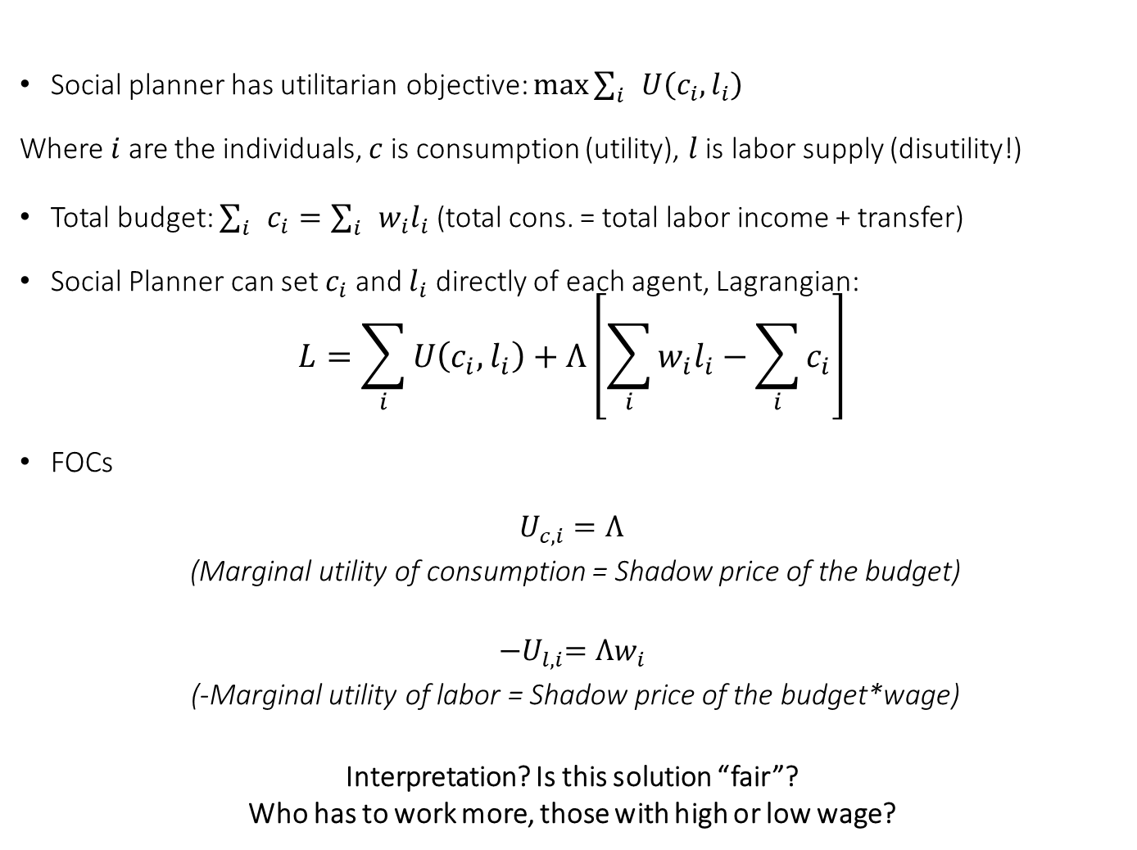
Example Redistribution of income: SP
Social planner has utilitarian objective: $\text{max}{\sum_{i}{U\left(c_{i},l_{i}\right)}}$
Where $i$ are the individuals, $c$ is consumption (utility), $l$ is labor supply (disutility!)
Total budget: $\sum_{i}{c_{i}}=\sum_{i}{w_{i}l_{i}}$ (total cons. = total labor income + transfer)
Social Planner can set $c_{i}$ and $l_{i}$ directly of each agent, Lagrangian:
$$L=\sum_{i}{U\left(c_{i},l_{i}\right)}+Λ\left[\sum_{i}{w_{i}l_{i}}−\sum_{i}{c_{i}}\right]$$
FOCs
$U_{c,i}=Λ$
(Marginal utility of consumption = Shadow price of the budget)
$${−U}_{l,i}=Λw_{i}$$
(-Marginal utility of labor = Shadow price of the budget*wage)
Interpretation? Is this solution “fair”?
Who has to work more, those with high or low wage?

Slide 7
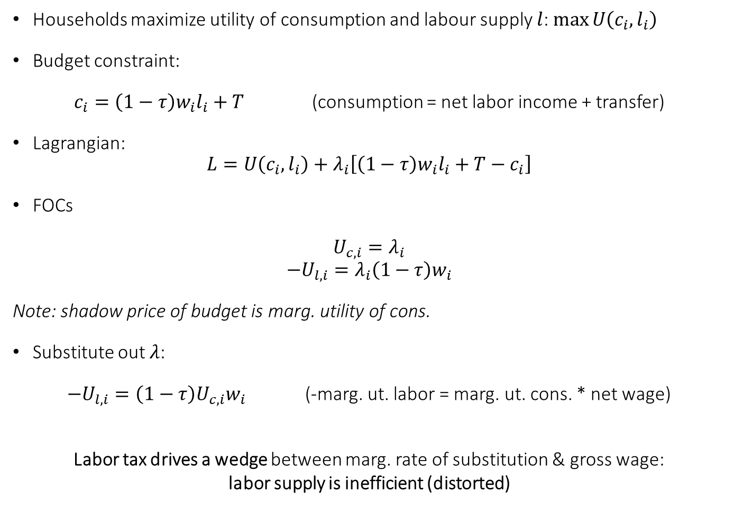
Redistribution in Decentralized Economy with Government: Labor tax + Lump Sum transfer
Households maximize utility of consumption and labour supply $l$: $\text{max}{U\left(c_{i},l_{i}\right)}$
Budget constraint:
$c_{i}=\left(1−τ\right)w_{i}l_{i}+T$ (consumption = net labor income + transfer)
Lagrangian:
$$L=U\left(c_{i},l_{i}\right)+λ_{i}\left[\left(1−τ\right)w_{i}l_{i}+T−c_{i}\right]$$
FOCs
$U_{c,i}=λ_{i}$
$$−U_{l,i}=λ_{i}\left(1−τ\right)w_{i}$$
Note: shadow price of budget is marg. utility of cons.
Substitute out $λ$:
$−U_{l,i}={\left(1−τ\right)U}_{c,i}w_{i}$ (-marg. ut. labor = marg. ut. cons. * net wage)
Labor tax drives a wedge between marg. rate of substitution & gross wage:
labor supply is inefficient (distorted)
Notes:
Omitted subscript i for brevity

Slide 8
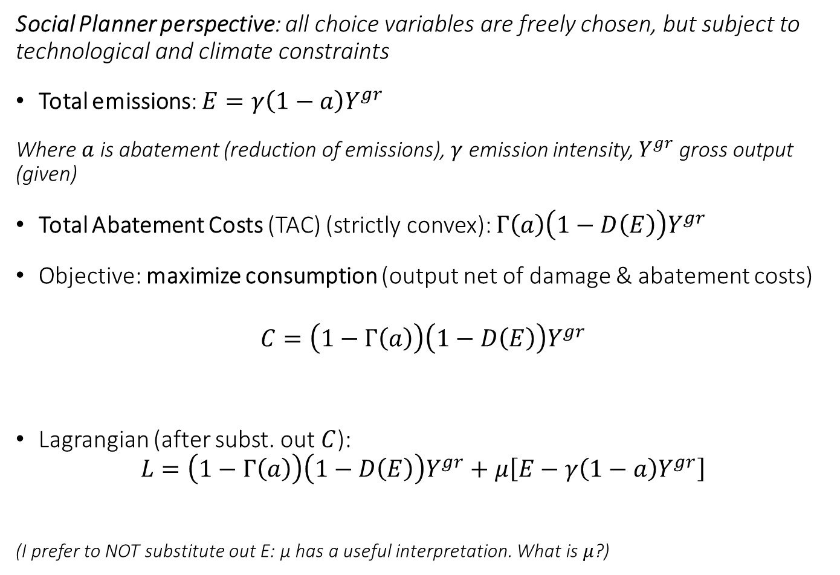
Simple Environmental Macro Model (static)
Social Planner perspective: all choice variables are freely chosen, but subject to technological and climate constraints
Total emissions: $E=γ\left(1−a\right)Y^{gr}$
Where $a$ is abatement (reduction of emissions), $γ$ emission intensity, $Y^{gr}$ gross output (given)
Total Abatement Costs (TAC) (strictly convex): $Γ\left(a\right)\left(1−D\left(E\right)\right)Y^{gr}$
Objective: maximize consumption (output net of damage & abatement costs)
$$C=\left(1−Γ\left(a\right)\right)\left(1−D\left(E\right)\right)Y^{gr}$$
Lagrangian (after subst. out $C$):
$$L=\left(1−Γ\left(a\right)\right)\left(1−D\left(E\right)\right)Y^{gr}+μ\left[E−γ\left(1−a\right)Y^{gr}\right]$$
(I prefer to NOT substitute out E: μ has a useful interpretation. What is $μ$?)

Slide 9
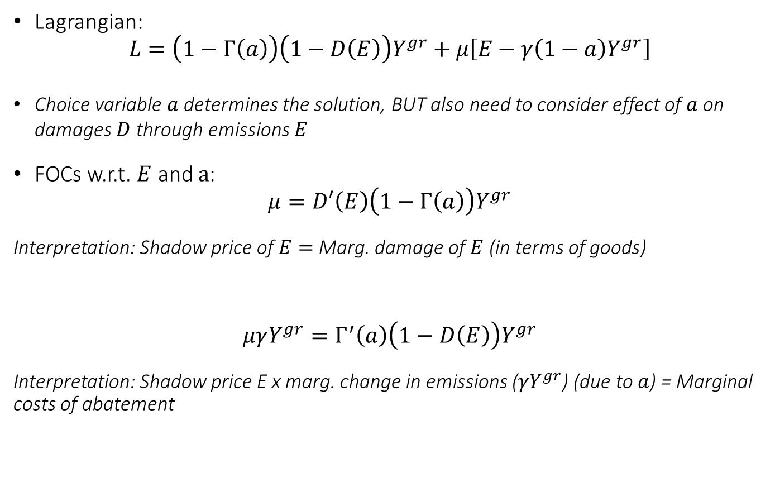
Simple Environmental Macro Model (static)
Lagrangian:
$$L=\left(1−Γ\left(a\right)\right)\left(1−D\left(E\right)\right)Y^{gr}+μ\left[E−γ\left(1−a\right)Y^{gr}\right]$$
Choice variable $a$ determines the solution, BUT also need to consider effect of $a$on damages $D$ through emissions $E$
FOCs w.r.t. $E$ and $a$:
$$μ=D′\left(E\right)\left(1−Γ\left(a\right)\right)Y^{gr}$$
Interpretation: Shadow price of $E=$Marg. damage of $E$ (in terms of goods)
$$μγY^{gr}=Γ^{′}\left(a\right)\left(1−D\left(E\right)\right)Y^{gr}$$
Interpretation: Shadow price E x marg. change in emissions ($γY^{gr}$) (due to $a$) = Marginal costs of abatement

Slide 10
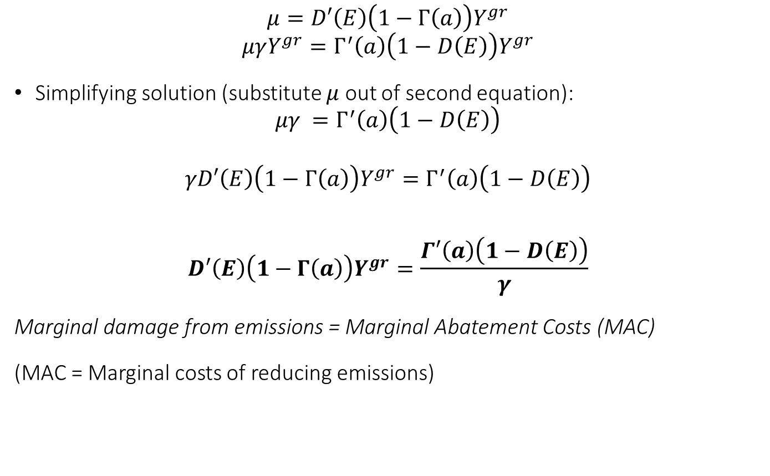
Solution after simplifying
$$μ=D′\left(E\right)\left(1−Γ\left(a\right)\right)Y^{gr}$$
$$μγY^{gr}=Γ^{′}\left(a\right)\left(1−D\left(E\right)\right)Y^{gr}$$
Simplifying solution (substitute $μ$ out of second equation):
$${μγ =Γ}^{′}\left(a\right)\left(1−D\left(E\right)\right)$$
$${γD′\left(E\right)\left(1−Γ\left(a\right)\right)Y^{gr}=Γ}^{′}\left(a\right)\left(1−D\left(E\right)\right)$$
$$D′\left(E\right)\left(1−Γ\left(a\right)\right)Y^{gr}=\frac{Γ′\left(a\right)\left(1−D\left(E\right)\right)}{γ}$$
Marginal damage from emissions = Marginal Abatement Costs (MAC)
(MAC = Marginal costs of reducing emissions)

Slide 11
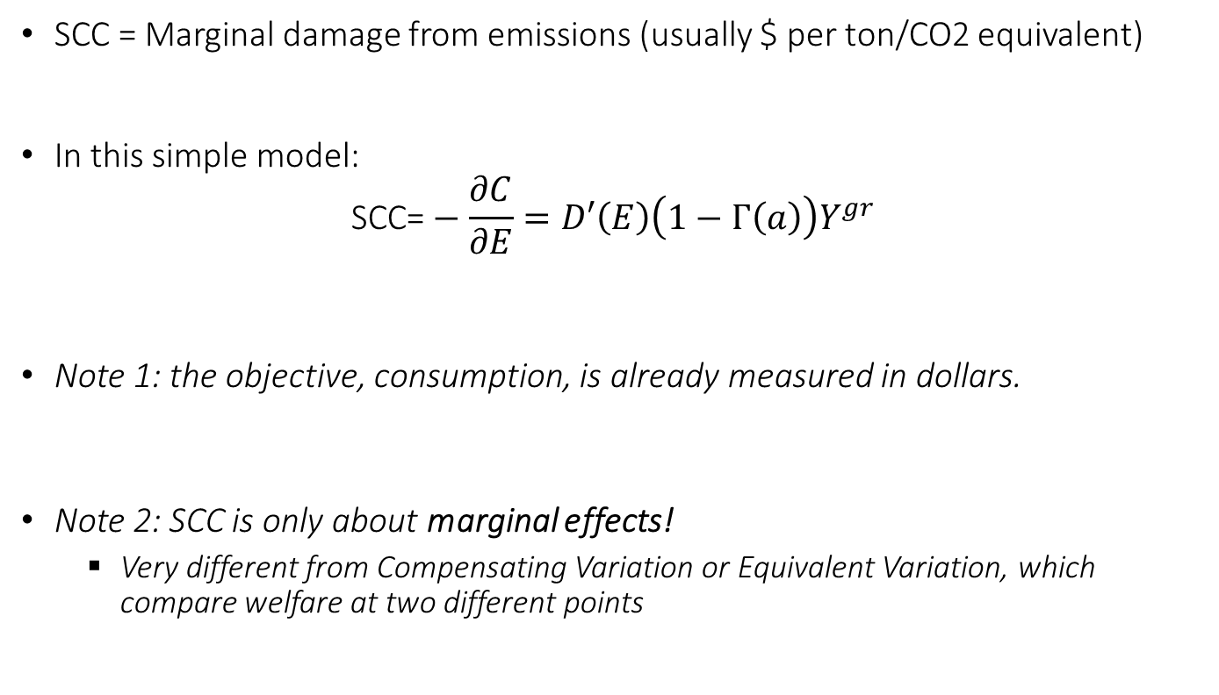
Social Cost of Carbon (here: flow damage only)
SCC = Marginal damage from emissions (usually $ per ton/CO2 equivalent)
In this simple model:
$$\text{SCC}\text{=}−\frac{∂C}{∂E}=D′\left(E\right)\left(1−Γ\left(a\right)\right)Y^{gr}$$
Note 1: the objective, consumption, is already measured in dollars.
Note 2: SCC is only about marginal effects!
Very different from Compensating Variation or Equivalent Variation, which compare welfare at two different points

Slide 12
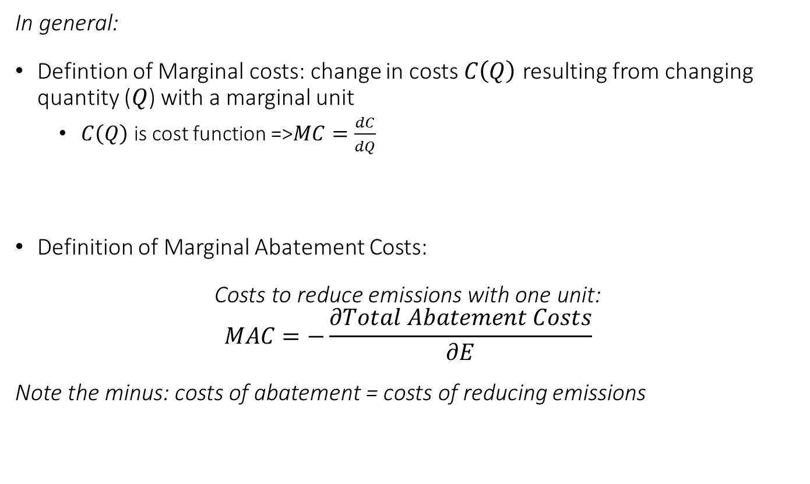
Marginal Abatement Costs
In general:
Defintion of Marginal costs: change in costs $C\left(Q\right)$ resulting from changing quantity ($Q$) with a marginal unit
$C\left(Q\right)$ is cost function =>$MC=\frac{dC}{dQ}$
Definition of Marginal Abatement Costs:
Costs to reduce emissions with one unit:
$$MAC=−\frac{∂Total Abatement Costs}{∂E}$$
Note the minus: costs of abatement = costs of reducing emissions

Slide 13
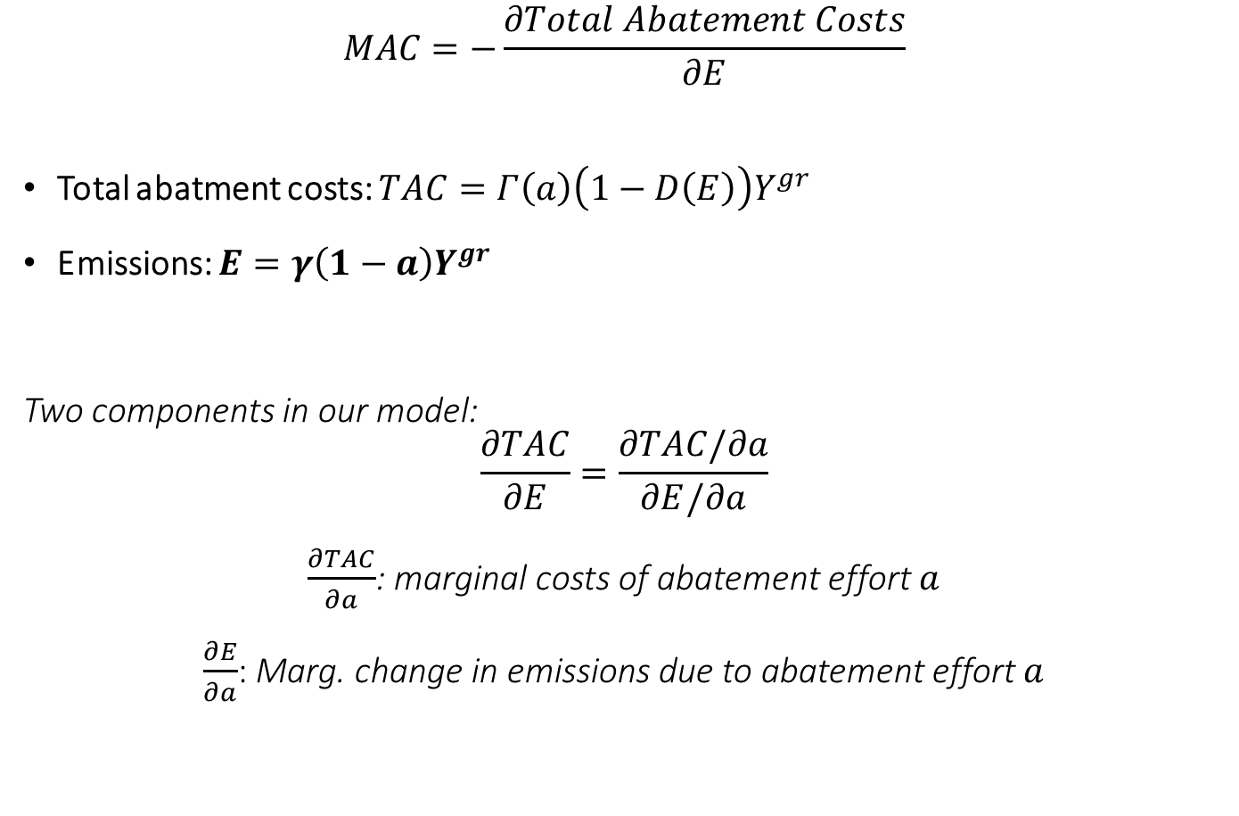
Marginal Abatement Costs
$$MAC=−\frac{∂Total Abatement Costs}{∂E}$$
Total abatment costs: $TAC=Γ\left(a\right)\left(1−D\left(E\right)\right)Y^{gr}$
Emissions: $E=γ\left(1−a\right)Y^{gr}$
Two components in our model:
$$\frac{∂TAC}{∂E}=\frac{∂TAC/∂a}{∂E/∂a}$$
$\frac{∂TAC}{∂a}$: marginal costs of abatement effort $a$
$\frac{∂E}{∂a}$: Marg. change in emissions due to abatement effort $a$

Slide 14
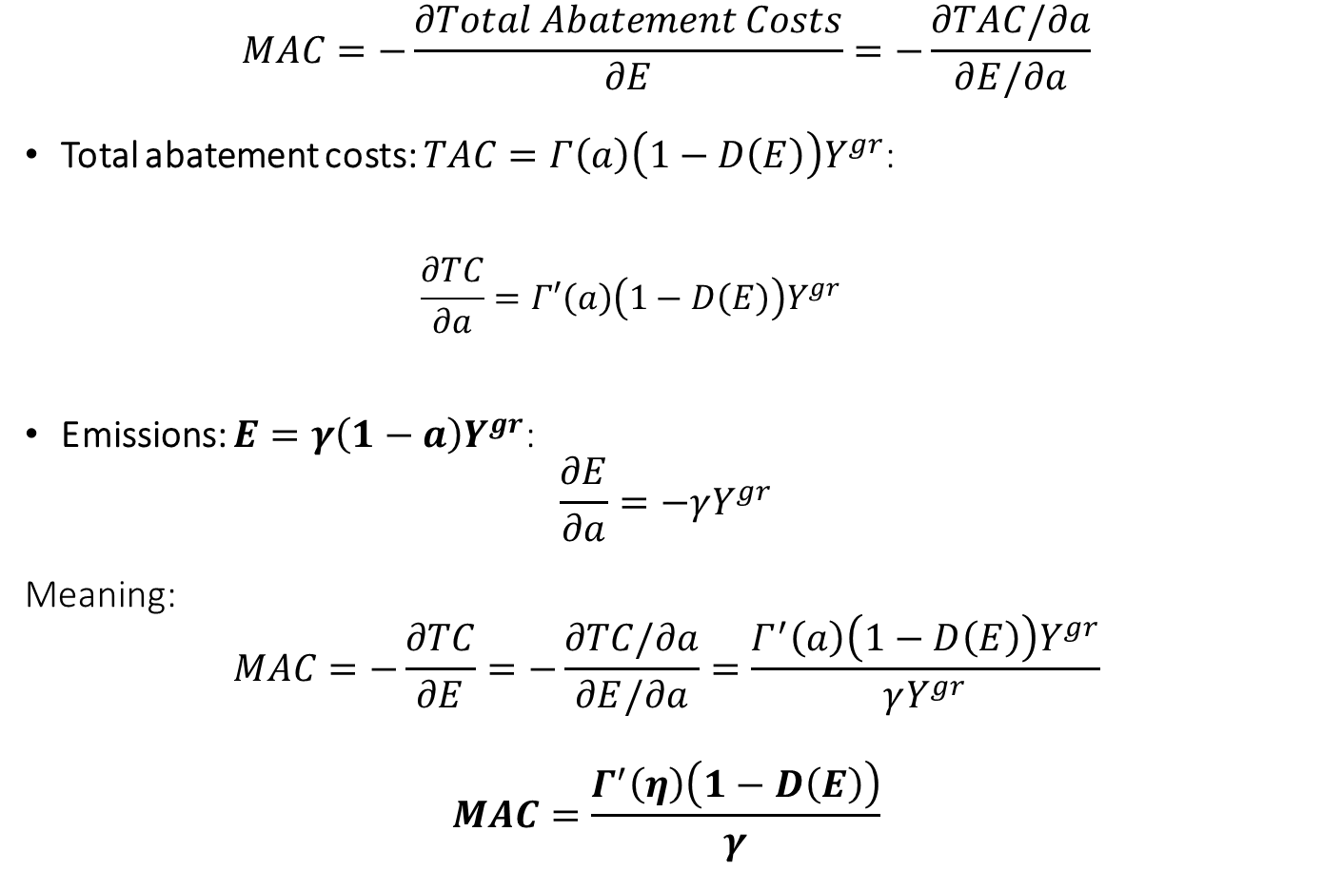
Marginal Abatement Costs
$$MAC=−\frac{∂Total Abatement Costs}{∂E}=−\frac{∂TAC/∂a}{∂E/∂a}$$
Total abatement costs: $TAC=Γ\left(a\right)\left(1−D\left(E\right)\right)Y^{gr}$:
$$\frac{∂TC}{∂a}=Γ′\left(a\right)\left(1−D\left(E\right)\right)Y^{gr}$$
Emissions: $E=γ\left(1−a\right)Y^{gr}$:
$$\frac{∂E}{∂a}=−γY^{gr}$$
Meaning:
$$MAC=−\frac{∂TC}{∂E}=−\frac{∂TC/∂a}{∂E/∂a}=\frac{Γ^{′}\left(a\right)\left(1−D\left(E\right)\right)Y^{gr}}{γY^{gr}}$$
$$MAC=\frac{Γ^{′}\left(η\right)\left(1−D\left(E\right)\right)}{γ}$$

Slide 15

Recap of Solution of Simple E-Macro
$$D′\left(E\right)\left(1−Γ\left(a\right)\right)Y^{gr}=\frac{Γ′\left(a\right)\left(1−D\left(E\right)\right)}{γ}$$
Social Cost of Carbon = Marginal Abatement Costs (MAC)

Slide 16
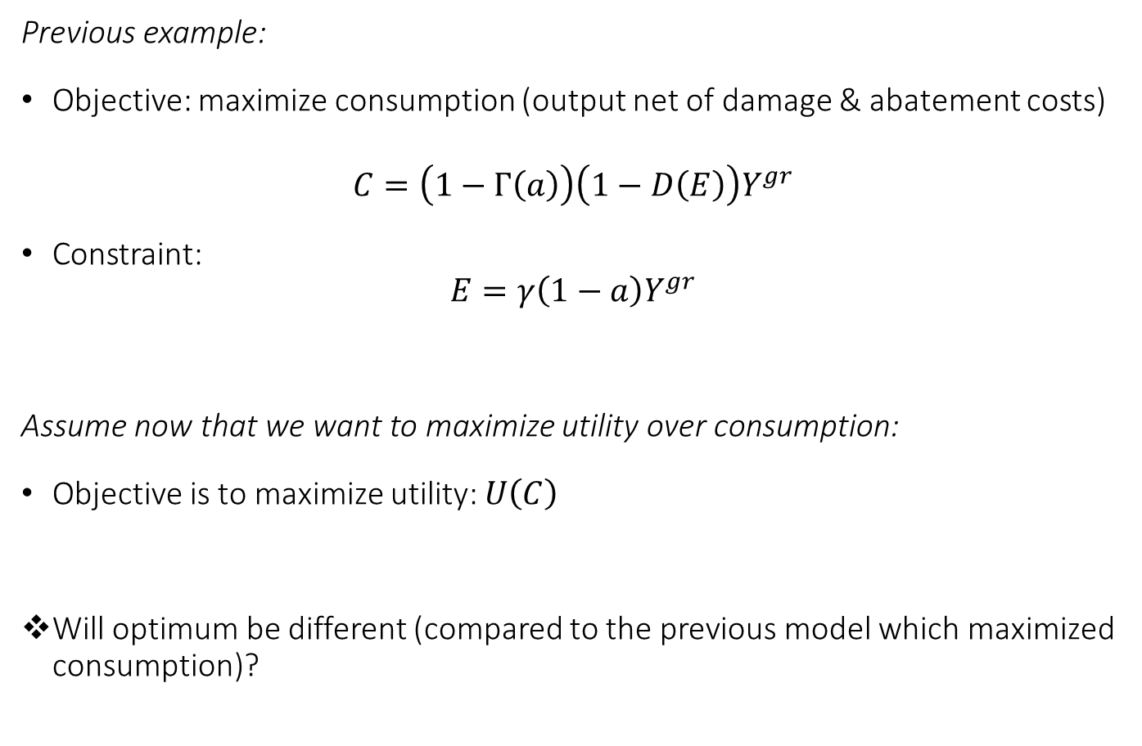
Environmental Macro Model with utility function(static)
Previous example:
Objective: maximize consumption (output net of damage & abatement costs)
$$C=\left(1−Γ\left(a\right)\right)\left(1−D\left(E\right)\right)Y^{gr}$$
Constraint:
$$E=γ\left(1−a\right)Y^{gr}$$
Assume now that we want to maximize utility over consumption:
Objective is to maximize utility: $U\left(C\right)$
Will optimum be different (compared to the previous model which maximized consumption)?

Slide 17
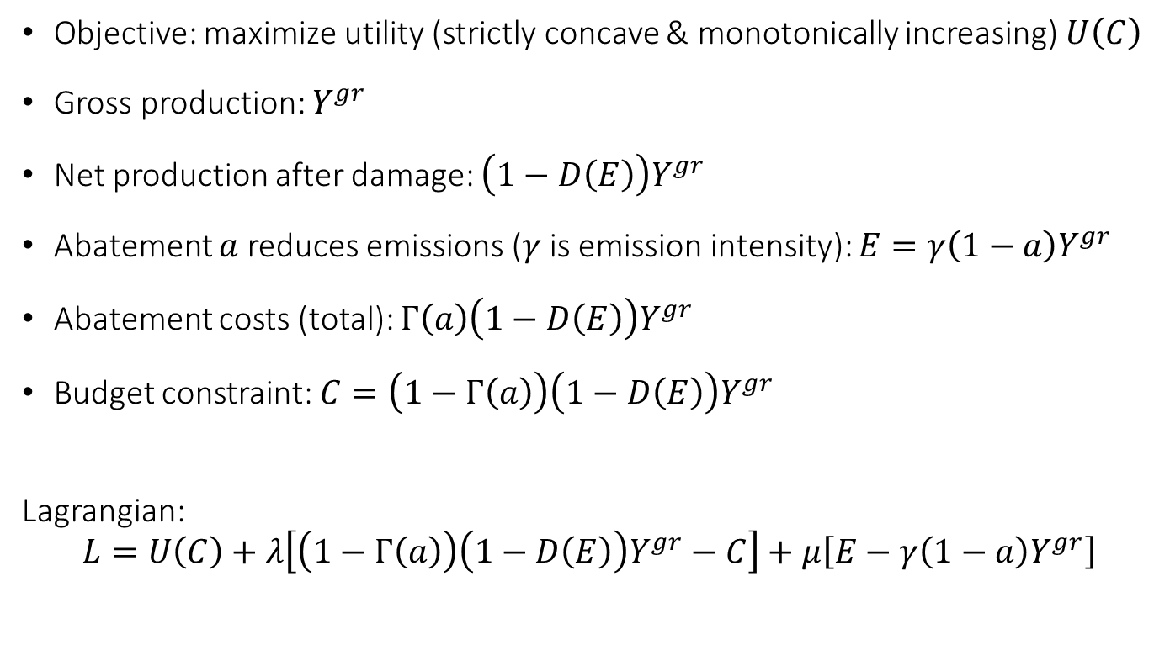
Static Climate Economic Model with utility of consumption: Social Planner solution
Objective: maximize utility (strictly concave & monotonically increasing) $U\left(C\right)$
Gross production: $Y^{gr}$
Net production after damage: $\left(1−D\left(E\right)\right)Y^{gr}$
Abatement $a$ reduces emissions ($γ$ is emission intensity): $E=γ\left(1−a\right)Y^{gr}$
Abatement costs (total): $Γ\left(a\right)\left(1−D\left(E\right)\right)Y^{gr}$
Budget constraint: $C=\left(1−Γ\left(a\right)\right)\left(1−D\left(E\right)\right)Y^{gr}$
Lagrangian:
$$L=U\left(C\right)+λ\left[\left(1−Γ\left(a\right)\right)\left(1−D\left(E\right)\right)Y^{gr}−C\right]+μ\left[E−γ\left(1−a\right)Y^{gr}\right]$$

Slide 18
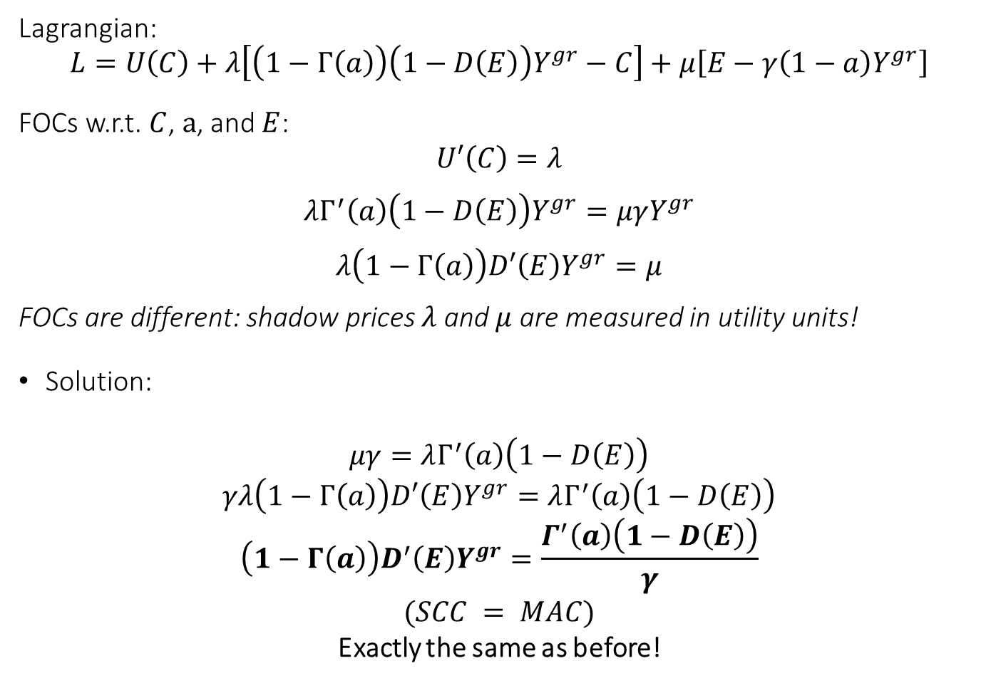
FOCs Social Planner
Lagrangian:
$$L=U\left(C\right)+λ\left[\left(1−Γ\left(a\right)\right)\left(1−D\left(E\right)\right)Y^{gr}−C\right]+μ\left[E−γ\left(1−a\right)Y^{gr}\right]$$
FOCs w.r.t. $C$, $a$, and $E$:
$$U′\left(C\right)=λ$$
$$λΓ^{′}\left(a\right)\left(1−D\left(E\right)\right)Y^{gr}=μγY^{gr}$$
$$λ\left(1−Γ\left(a\right)\right)D′\left(E\right)Y^{gr}=μ$$
FOCs are different: shadow prices $λ$ and $μ$ are measured in utility units!
Solution:
$$μγ=λΓ^{′}\left(a\right)\left(1−D\left(E\right)\right)$$
$$γλ\left(1−Γ\left(a\right)\right)D′\left(E\right)Y^{gr}=λΓ^{′}\left(a\right)\left(1−D\left(E\right)\right)$$
$$\left(1−Γ\left(a\right)\right)D^{′}\left(E\right)Y^{gr}=\frac{Γ^{′}\left(a\right)\left(1−D\left(E\right)\right)}{γ}$$
$$(SCC = MAC)$$
Exactly the same as before!

Slide 19
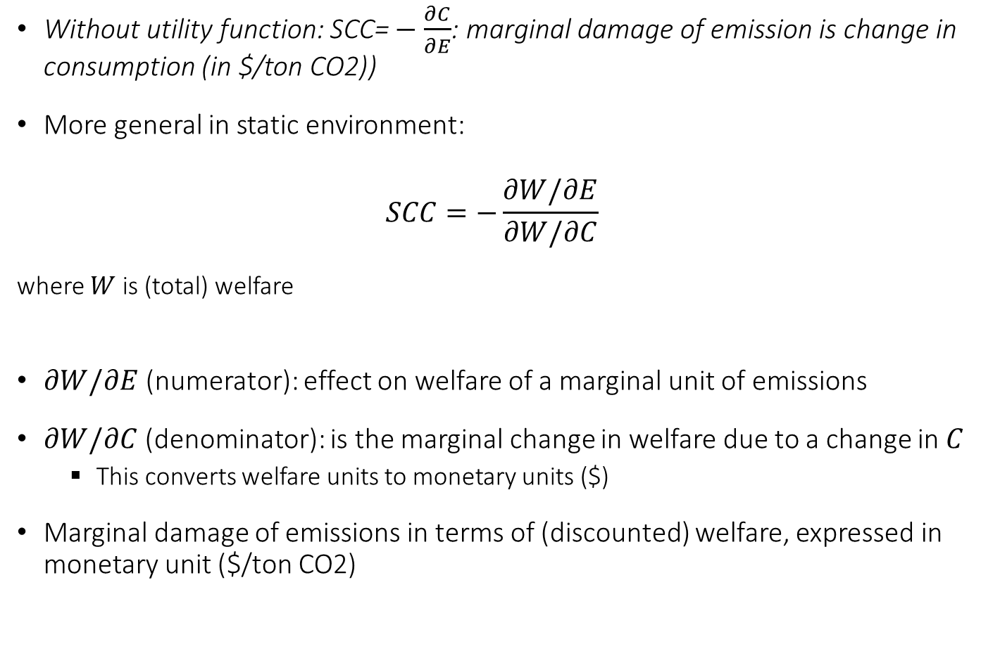
Social Cost of Carbon (static)
Without utility function: $\text{SCC}\text{=}−\frac{∂C}{∂E}$: marginal damage of emission is change in consumption (in $/ton CO2))
More general in static environment:
$$SCC=−\frac{∂W/∂E}{∂W/∂C}$$
where $W$ is (total) welfare
$∂W/∂E$(numerator): effect on welfare of a marginal unit of emissions
$∂W/∂C$(denominator): is the marginal change in welfare due to a change in $C$
This converts welfare units to monetary units ($)
Marginal damage of emissions in terms of (discounted) welfare, expressed in monetary unit ($/ton CO2)

Slide 20
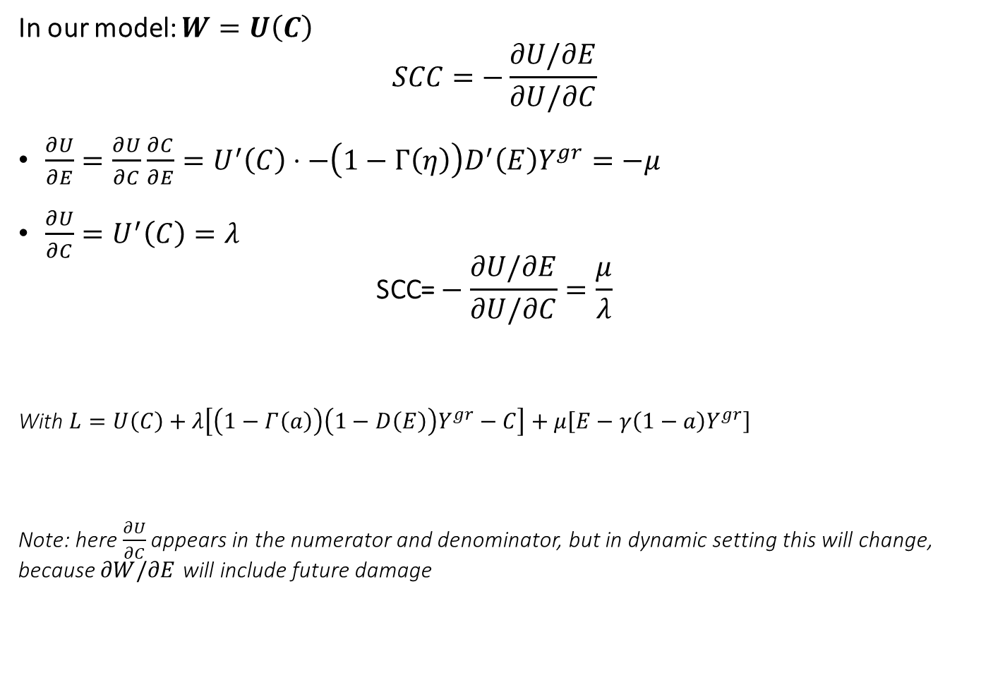
Social Cost of Carbon
In our model: $W=U\left(C\right)$
$$SCC=−\frac{∂U/∂E}{∂U/∂C}$$
$\frac{∂U}{∂E}=\frac{∂U}{∂C}\frac{∂C}{∂E}=U^{′}\left(C\right)⋅−\left(1−Γ\left(η\right)\right)D^{′}\left(E\right)Y^{gr}=−μ$
$\frac{∂U}{∂C}=U^{′}\left(C\right)=λ$
$$\text{SCC}\text{=}−\frac{∂U/∂E}{∂U/∂C}=\frac{μ}{λ}$$
With $L=U\left(C\right)+λ\left[\left(1−Γ\left(a\right)\right)\left(1−D\left(E\right)\right)Y^{gr}−C\right]+μ\left[E−γ\left(1−a\right)Y^{gr}\right]$
Note: here $\frac{∂U}{∂C}$ appears in the numerator and denominator, but in dynamic setting this will change, because $∂W/∂E$ will include future damage

Slide 21
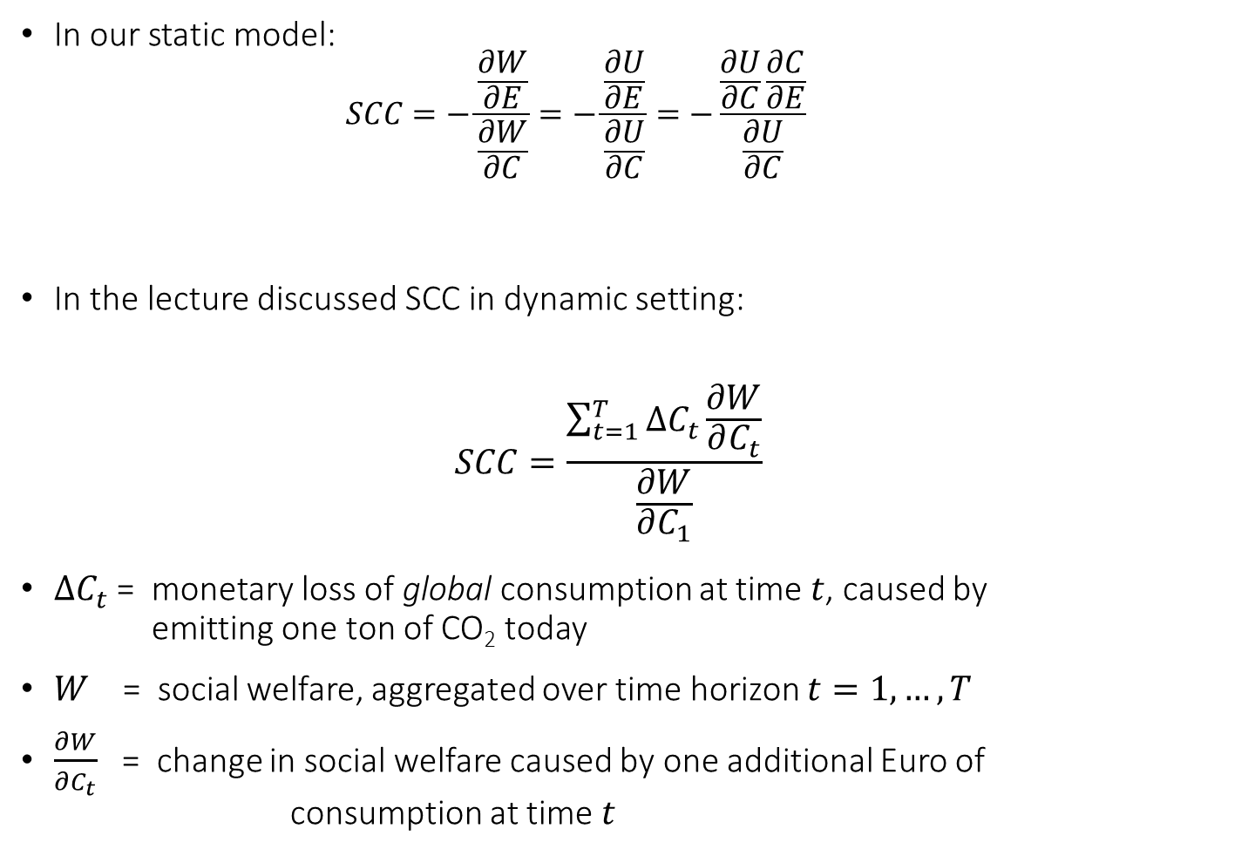
Comparison with definition in lecture
In our static model:
$$SCC=−\frac{\frac{∂W}{∂E}}{\frac{∂W}{∂C}}=−\frac{\frac{∂U}{∂E}}{\frac{∂U}{∂C}}=−\frac{\frac{∂U}{∂C}\frac{∂C}{∂E}}{\frac{∂U}{∂C}}$$
In the lecture discussed SCC in dynamic setting:
$$SCC=\frac{\sum_{t=1}^{T}{∆C_{t}\frac{∂W}{∂C_{t}}}}{\frac{∂W}{∂C_{1}}}$$
$∆C_{t}$ = monetary loss of global consumption at time $t$, caused by emitting one ton of CO₂ today
$W$ = social welfare, aggregated over time horizon $t=1,…,T$
$\frac{∂W}{∂C_{t}}$ = change in social welfare caused by one additional Euro of consumption at time $t$

Slide 22
Labor supply in E-Macro
Assume: utility over consumption & labour
See Example Redistribution
Production results in emissions => emissions result in damage (negative externality)
No abatement technology => can only reduce emissions by producing less
Use Social Planner

Slide 23
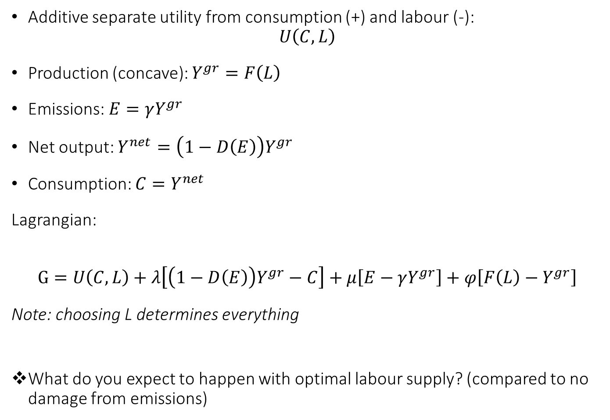
Labor supply in E-Macro
Additive separate utility from consumption (+) and labour (-): $U\left(C,L\right)$
Production (concave): $Y^{gr}=F\left(L\right)$
Emissions: $E=γY^{gr}$
Net output: $Y^{net}=\left(1−D\left(E\right)\right)Y^{gr}$
Consumption: $C=Y^{net}$
Lagrangian:
$$G=U\left(C,L\right)+λ\left[\left(1−D\left(E\right)\right)Y^{gr}−C\right]+μ\left[E−γY^{gr}\right]+φ\left[F\left(L\right)−Y^{gr}\right]$$
Note: choosing L determines everything
What do you expect to happen with optimal labour supply? (compared to no damage from emissions)

Slide 24
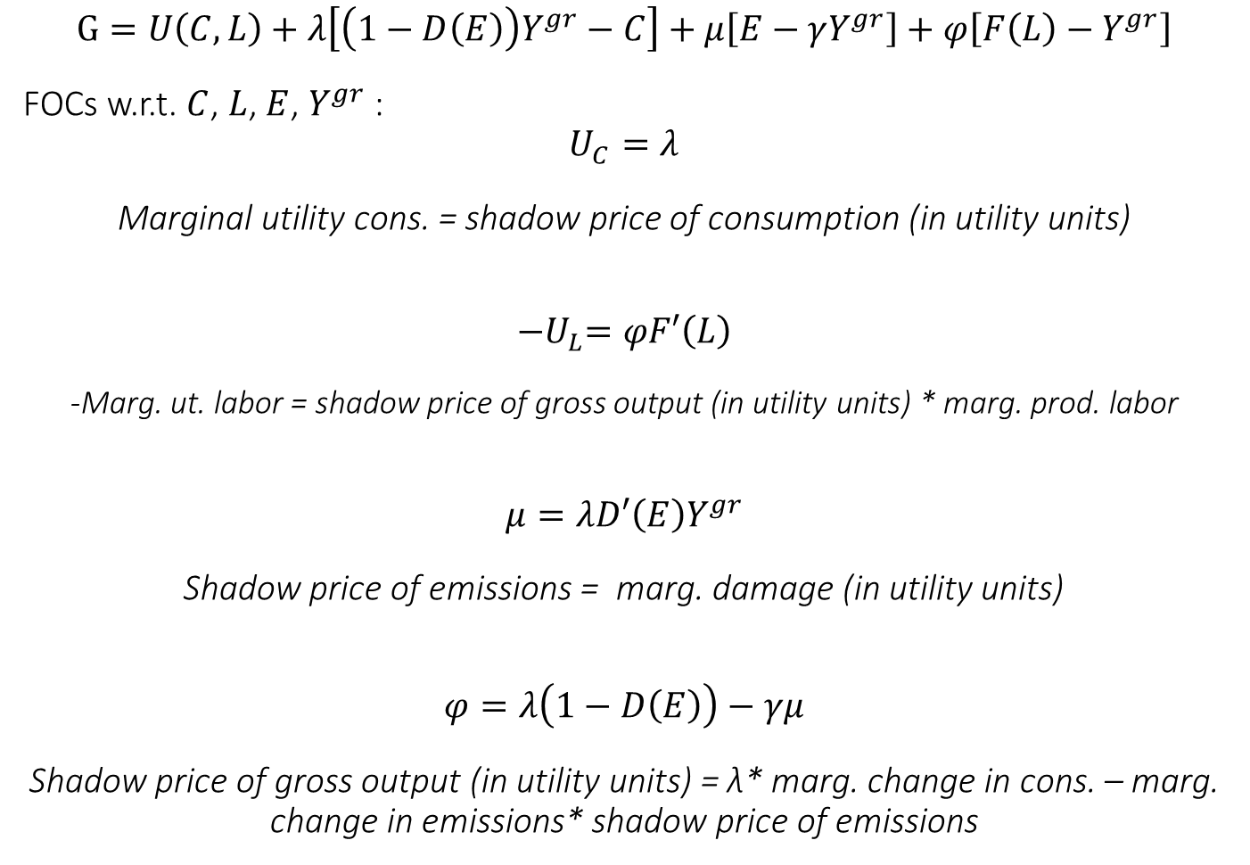
Optimization
$$G=U\left(C,L\right)+λ\left[\left(1−D\left(E\right)\right)Y^{gr}−C\right]+μ\left[E−γY^{gr}\right]+φ\left[F\left(L\right)−Y^{gr}\right]$$
FOCs w.r.t. $C$, $L$, $E$, $Y^{gr}$:
$$U_{C}=λ$$
Marginal utility cons. = shadow price of consumption (in utility units)
$${−U}_{L}=φF′\left(L\right)$$
-Marg. ut. labor = shadow price of gross output (in utility units) * marg. prod. labor
$$μ=λD′\left(E\right)Y^{gr}$$
Shadow price of emissions = marg. damage (in utility units)
$$φ=λ\left(1−D\left(E\right)\right)−γμ$$
Shadow price of gross output (in utility units) = λ* marg. change in cons. – marg. change in emissions* shadow price of emissions
Notes:
Marginal utility = shadow price of consumption
-Marginal utility of labor = shadow price of gross output (in utility units) * marg. Productivity
Shadow price of emissions = marg. Damage (in utility units)
Shadow price of consumption * marg. Change in cons. – shadow price of emissions * marg. Change in emissions = Shadow price of gross output (in utility units)

Slide 25
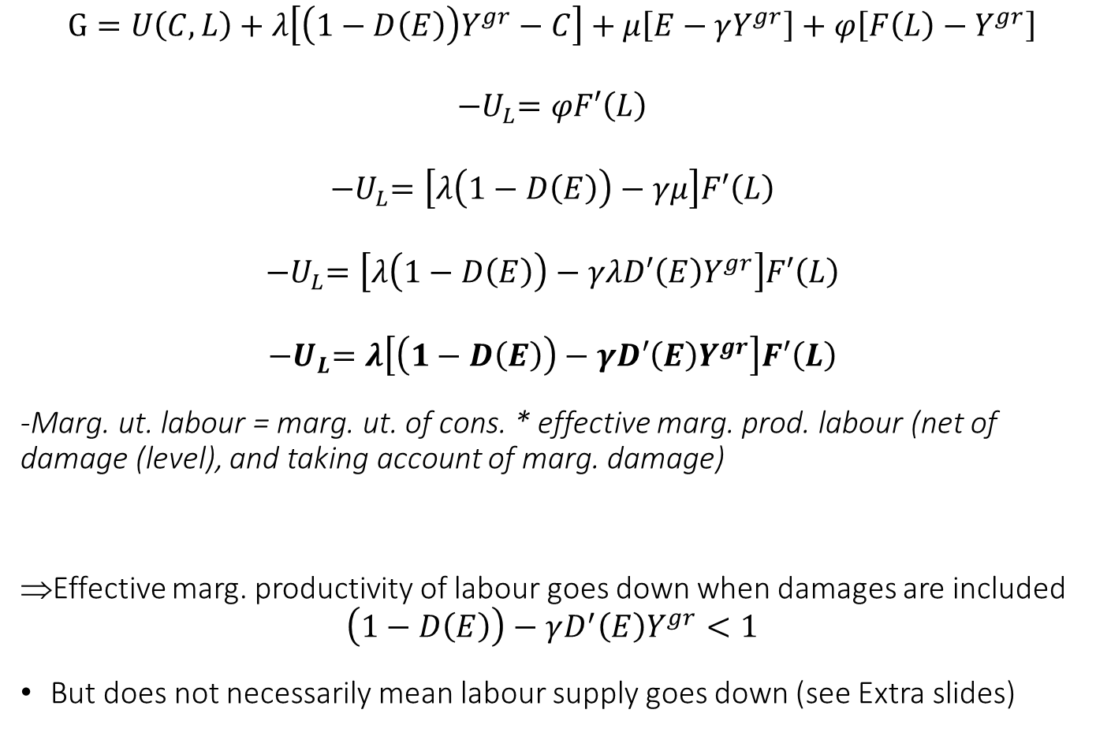
Simplifying
$$G=U\left(C,L\right)+λ\left[\left(1−D\left(E\right)\right)Y^{gr}−C\right]+μ\left[E−γY^{gr}\right]+φ\left[F\left(L\right)−Y^{gr}\right]$$
$${−U}_{L}=φF′\left(L\right)$$
$${−U}_{L}=\left[λ\left(1−D\left(E\right)\right)−γμ\right]F′\left(L\right)$$
$${−U}_{L}=\left[λ\left(1−D\left(E\right)\right)−γλD′\left(E\right)Y^{gr}\right]F′\left(L\right)$$
$${−U}_{L}=λ\left[\left(1−D\left(E\right)\right)−γD′\left(E\right)Y^{gr}\right]F′\left(L\right)$$
-Marg. ut. labour = marg. ut. of cons. * effective marg. prod. labour (net of damage (level), and taking account of marg. damage)
Effective marg. productivity of labour goes down when damages are included
$$\left(1−D\left(E\right)\right)−γD^{′}\left(E\right)Y^{gr}<1$$
But does not necessarily mean labour supply goes down (see Extra slides)
Notes:
Marginal utility = shadow price of consumption
-Marginal utility of labor = shadow price of gross output (in utility units) * marg. Productivity
Shadow price of emissions = marg. Damage (in utility units)
Shadow price of consumption * marg. Change in cons. – shadow price of emissions * marg. Change in emissions = Shadow price of gross output (in utility units)

Slide 26

Extra: Income & Substitution effect with additive separable utility function
Common macroeconomic utility: $U\left(c,l\right)=\frac{c^{1−ν}−1}{1−ν}−χ\frac{l^{1+\frac{1}{φ}}}{1+\frac{1}{φ}}$
$$U_{c}=c^{−ν}$$
$$U_{l}=−χl^{\frac{1}{φ}}$$
Assume $c=wl$:$−\frac{U_{l}}{U_{c}}=w$ => $\frac{χl^{\frac{1}{φ}}}{w^{−ν}l^{−ν}}=w$ =>
$χl^{\frac{νφ+ 1}{φ}}=w^{1−ν}$
Note: $\frac{νφ+ 1}{φ}>0$
$ν<1$ => $\frac{dl}{dw}>0$: substitution effect dominates
$ν>1$ => $\frac{dl}{dw}<0$: income effect dominates
$ν=1$ (log utility) => $\frac{dl}{dw}=0$: income effect and substitution effect cancel

Slide 27
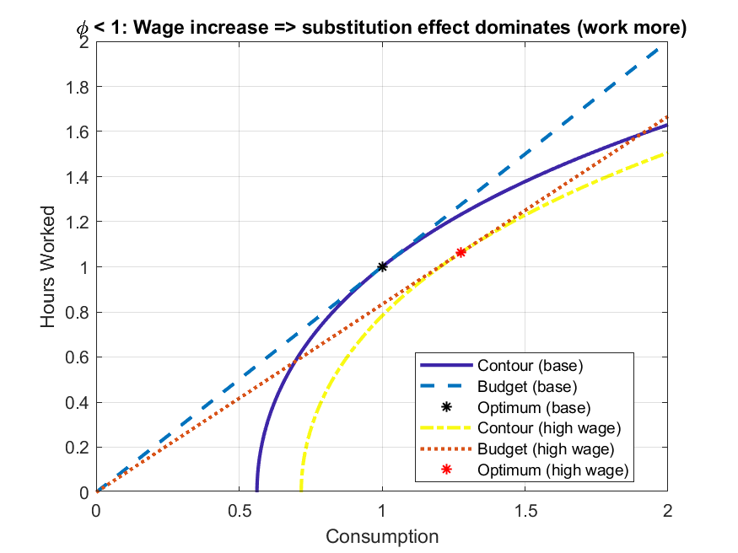

Slide 28
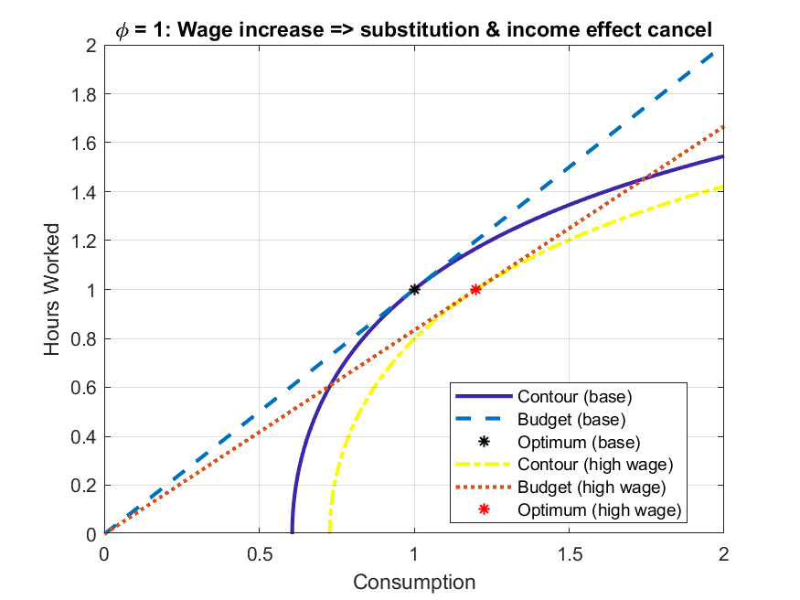

Slide 29
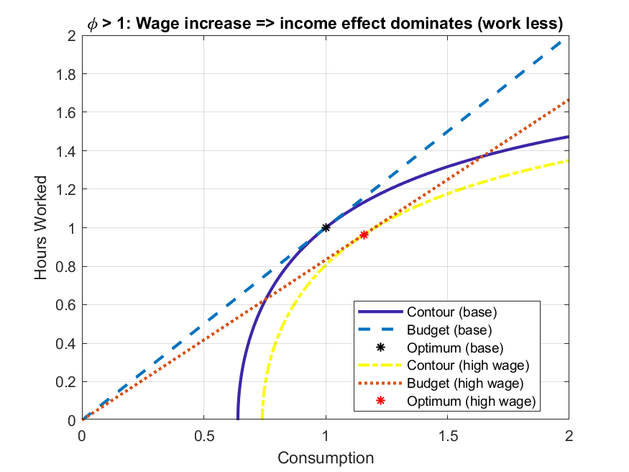

Slide 30

Max Frank’s Evaluation
Please take a few minutes to complete Max’s evaluation for this semester;
https://befragung.tu-berlin.de/evasys/online.php?p=ME1CY

